Slide 1
Frontend Architecture
By Talha Ahmad

Slide 2
Why Architecture?
Software architecture is the fundamental blueprint of a system. It is vital because it manages complexity, aligns technical solutions with business goals, and dictates essential quality attributes like scalability, security, and maintainability. A strong architectural foundation prevents costly future reworks. The core benefits are:
Manage Complexity
Drives Quality Attributes
Improves Maintainability
Align Teams

Slide 3
What is Vertical Slice Architecture (VSA)?
Vertical Slice Architecture is a design approach that organizes software by feature or business use case rather than technical layers. Each "slice" encapsulates all necessary components—like presentation, business logic, and data access—drastically reducing the complexity of making changes across a large codebase. A typical feature may include:
Controller/Endpoint (Routes)
Request/Response DTOs (Schemas)
Validation
Handler
Data Access

Slide 4
Advantages of VSA in Frontend
Vertical Slice Architecture (VSA) in a frontend framework like React organizes code by business feature or use case rather than by technical layers (e.g., separating components, hooks, and services). Each feature folder is self-contained and holds everything needed for that specific capability. The main advantages are:
Faster Development & Onboarding
Independent Feature Iteration
Easy Refactoring & Deletion
Reduced Coupling

Slide 5
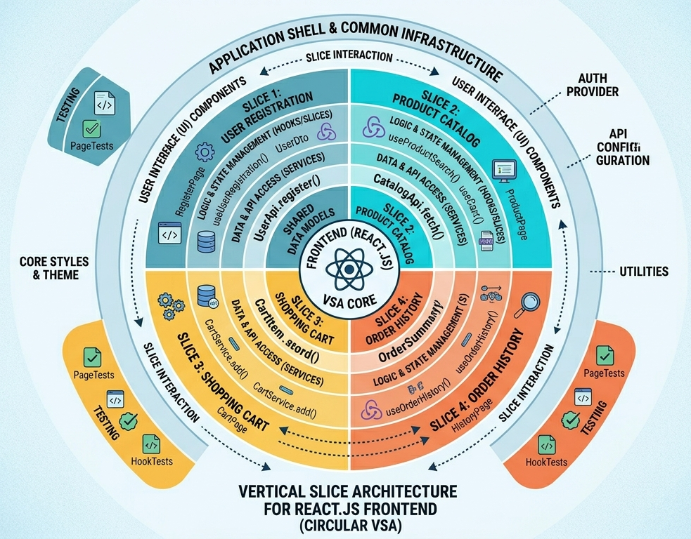
Vertical Slice Architecture - Diagram

Slide 6
Clean code Principles
SOLID - Isolated features, dependency inversion via hooks/services, and reusable abstractions.
DRY (Don’t Repeat Yourself) – Shared UI components, shared hooks, and shared utilities.
KISS (Keep It Simple, Stupid) – Avoid redux overengineering, deep abstraction chains, and massive generic code.

Slide 7
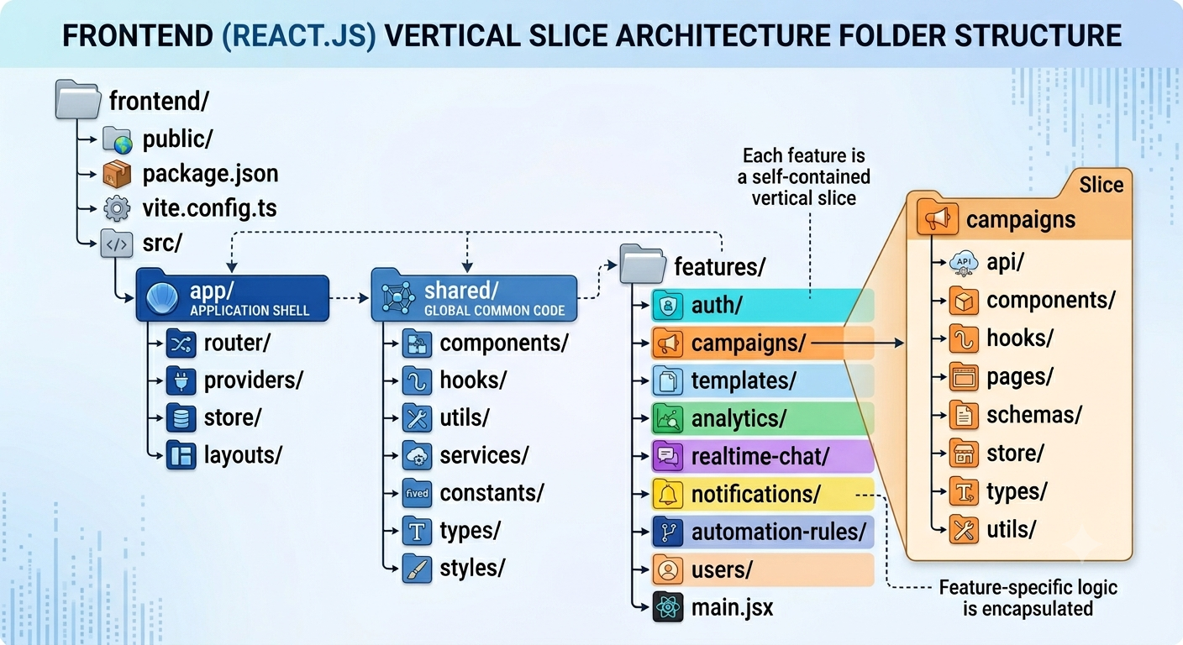
Folder Structure

Slide 8
The End
Any Queries?

